Slide 1

Praticum(exame) Marcio Matias ST10443172
The Weather App

Slide 2
Objective: To provide users with weekly weather information, including average temperatures and detailed daily weather conditions.
Key Features:
Display of average weekly temperature
Detailed daily weather information
User-friendly interface with smooth navigation

Slide 3
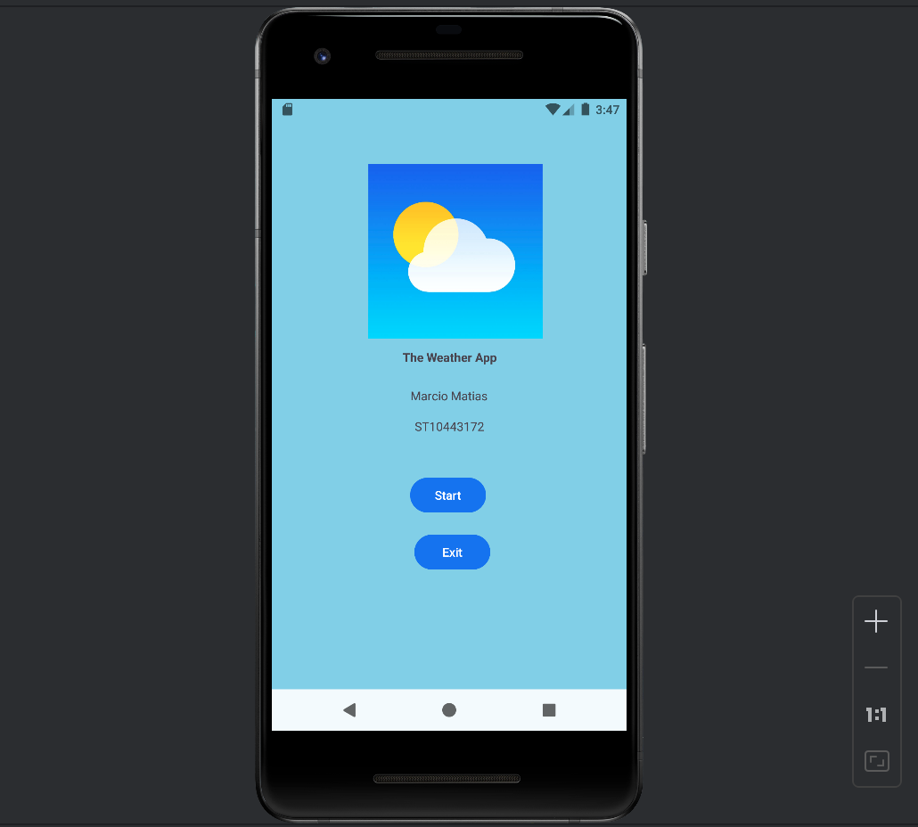
Splash Screen
Initial screen with app name, student's name, and student number. Options to navigate to the main screen or exit the app.

Slide 4
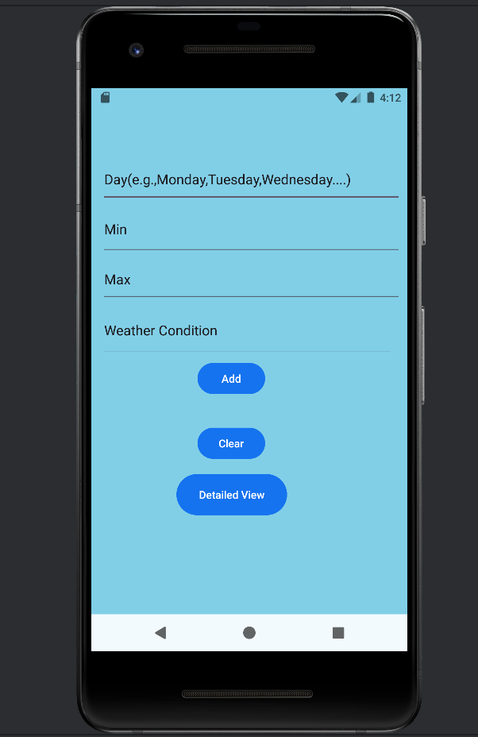
-Input fields for daily weather data
-Calculation and display of average weekly temperature.
-Buttons to navigate to the detailed view screen and exit the app.

Slide 5
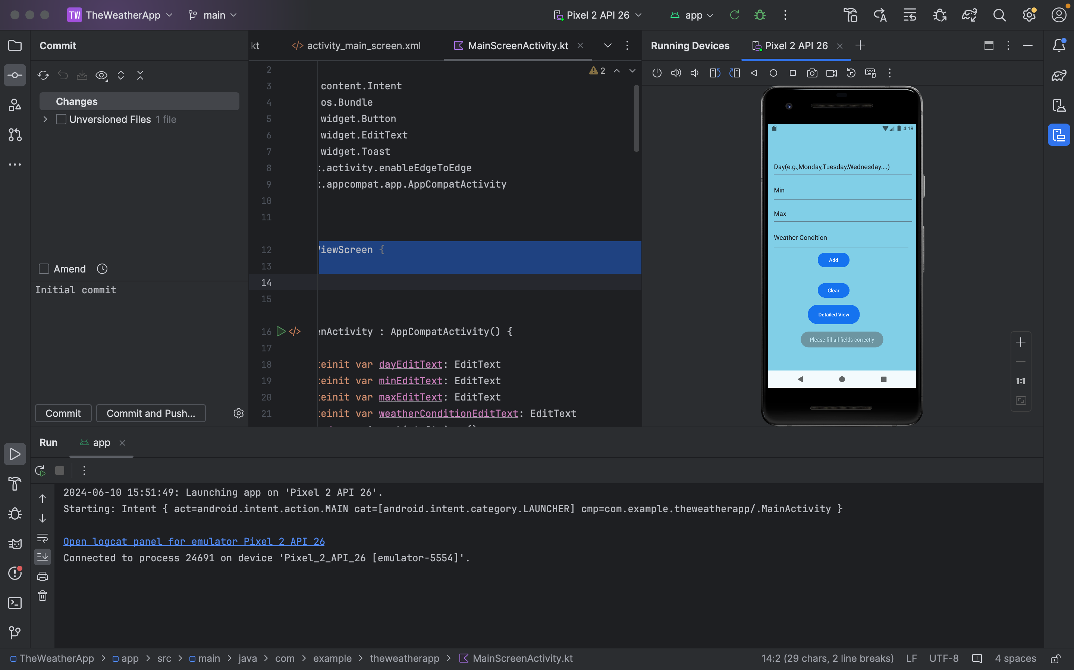
Data Handling

Slide 6
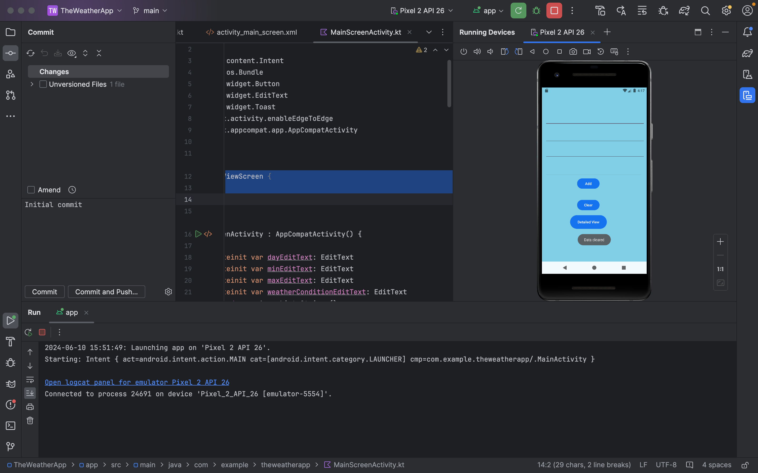
Error Handling

